Slide 1

SEP1Y Final Project

Slide 2




INTRODUCTION
The embassy

Slide 3

Bob needs help
VIA’s timetable manager is missing a tool to do his job.

Slide 4
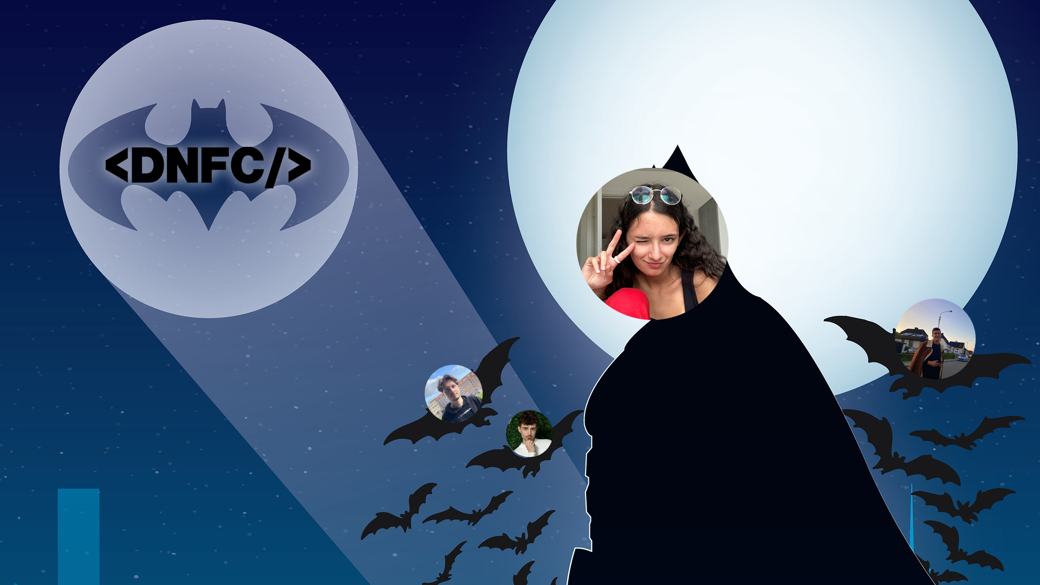
And then, when hope was lost…
…DNFC team showed up.

Slide 5

Demonstration Time (Fun Part)

Slide 6

Project Initiation
Project Description
Analysis
Design

Slide 7

Analysis
A list of requirements and use cases were formulated according to the Project Description.

Slide 8
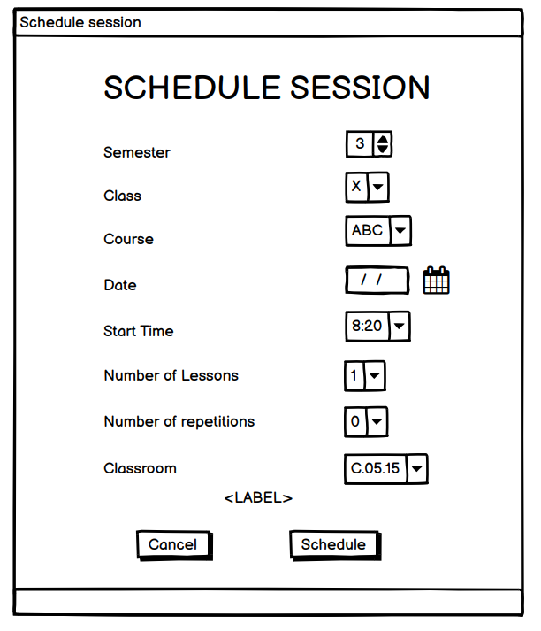
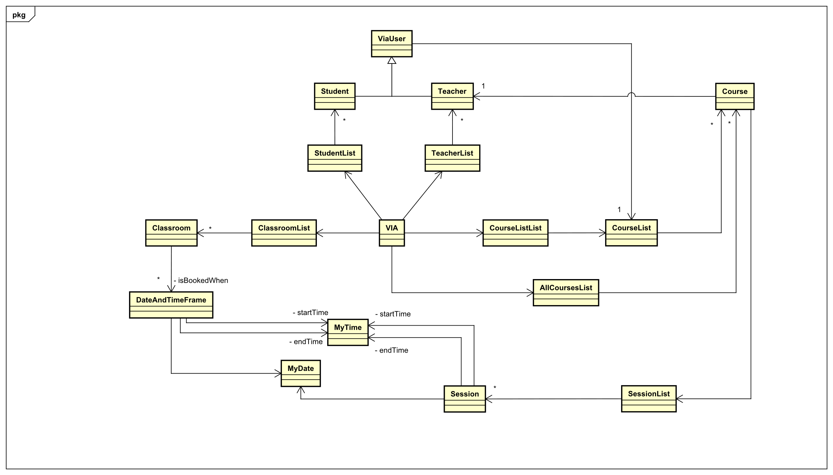
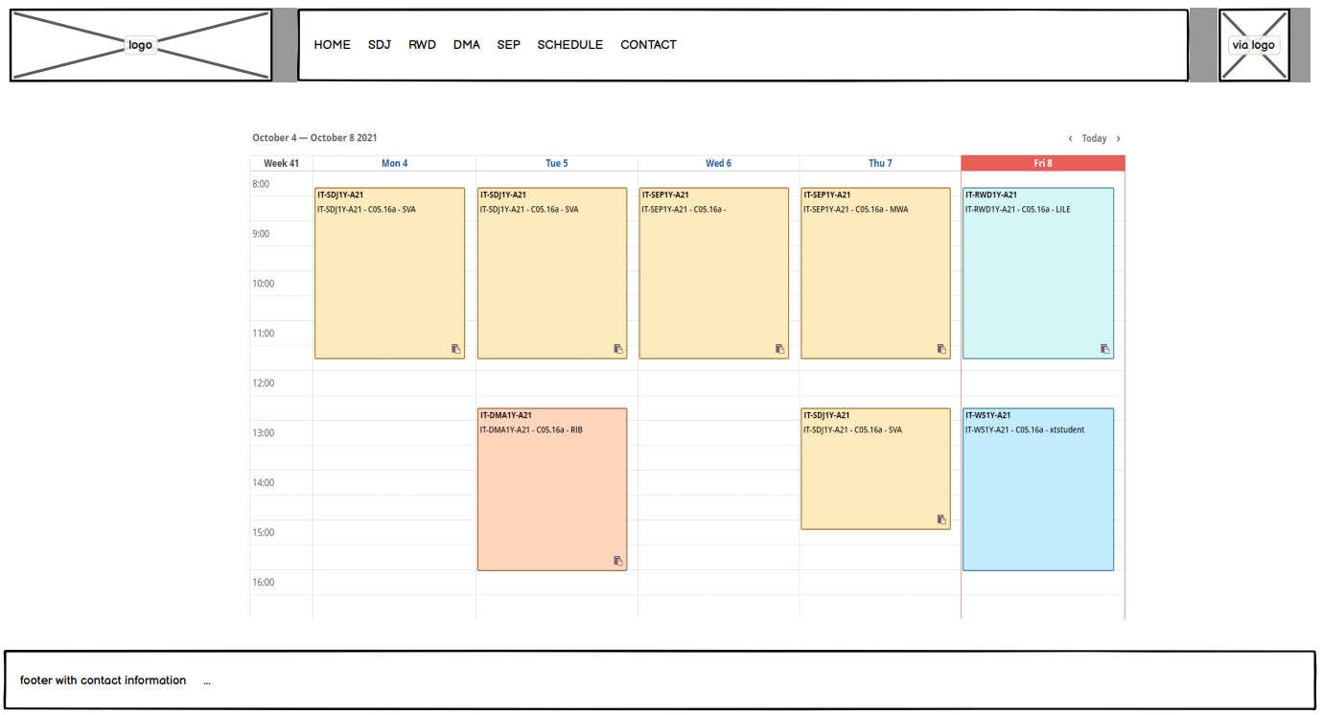
Design

Slide 9

Implementation
After planning, it was finally time to code.

Slide 10
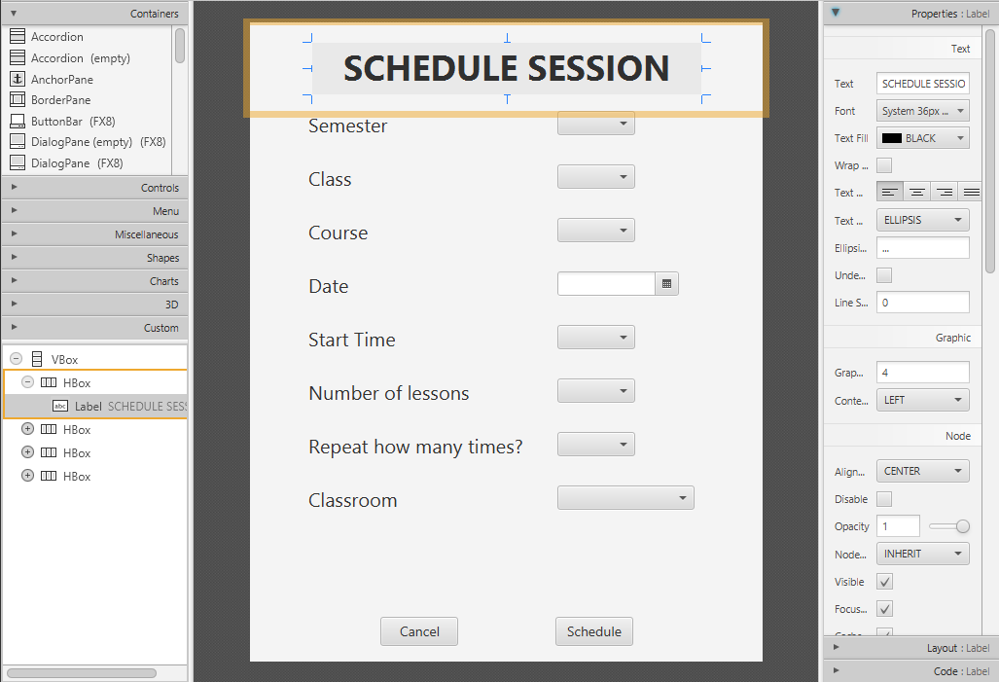
Graphical User Interface
The GUI was done first so that we wouldn’t code “in the dark”.

Slide 11
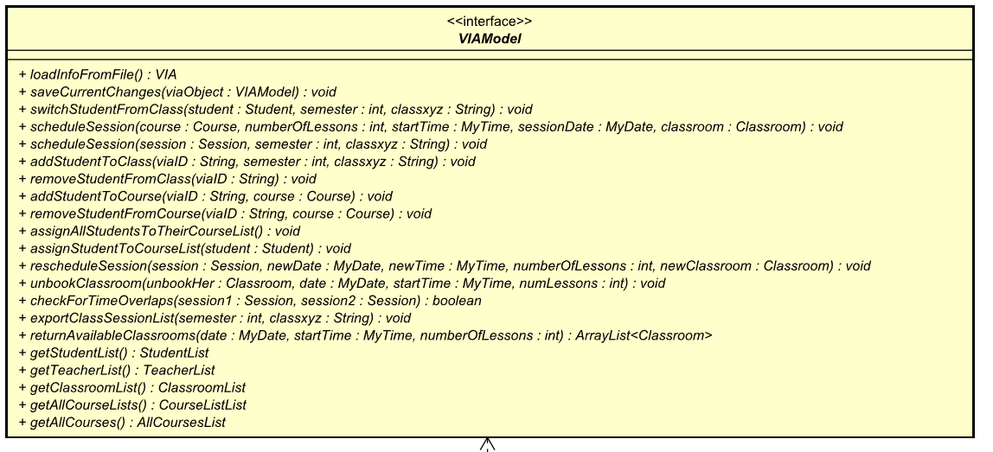

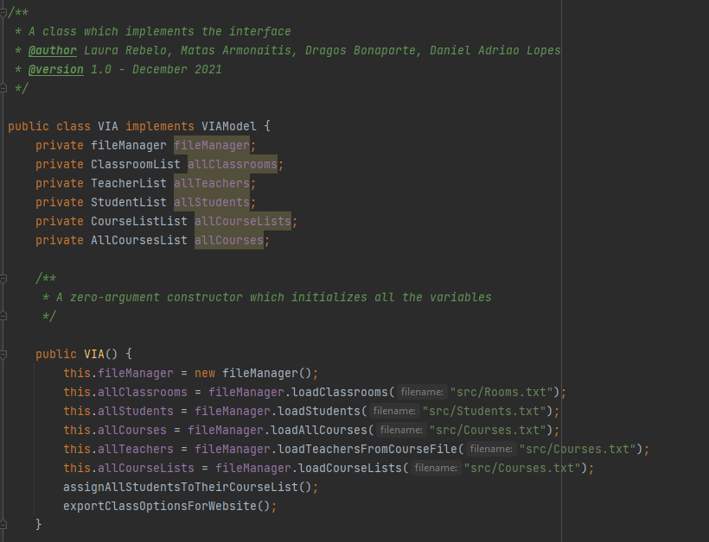
Coding Classes
Where the Chinese programmers come in

Slide 12

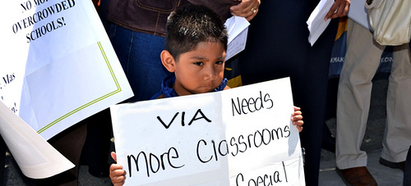
Important Functionalities
Check for time overlaps
Check for classroom overlaps

Slide 13
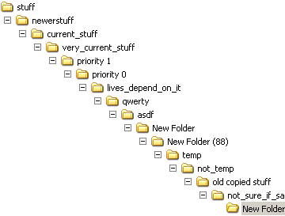
Persistence
Maintaining persistence was achieved through files.

Slide 14

HTML and JavaScript

Slide 15
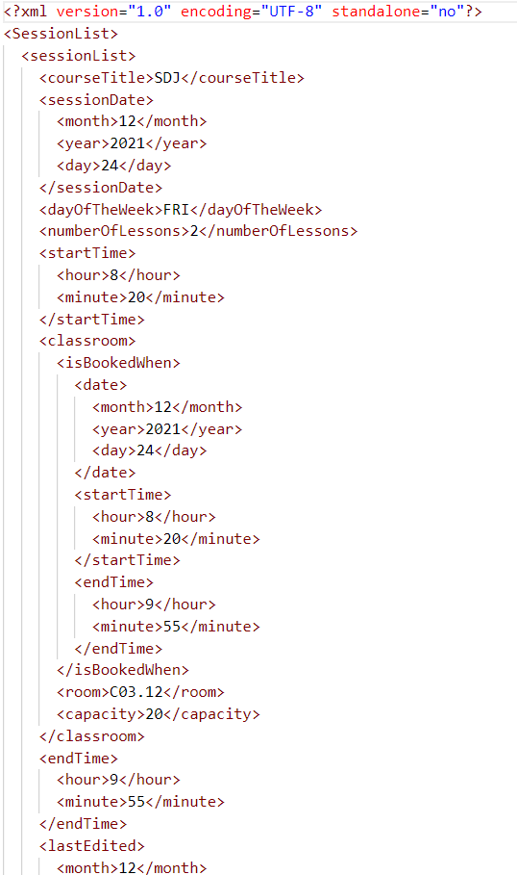
XML files
The Java application can export XML files inside of the website directory.
These will then be parsed with JavaScript.

Slide 16
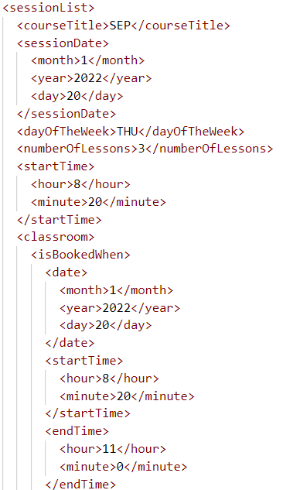
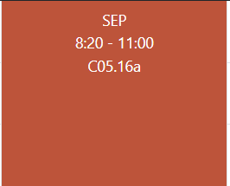
From XML to Timetable

Slide 17
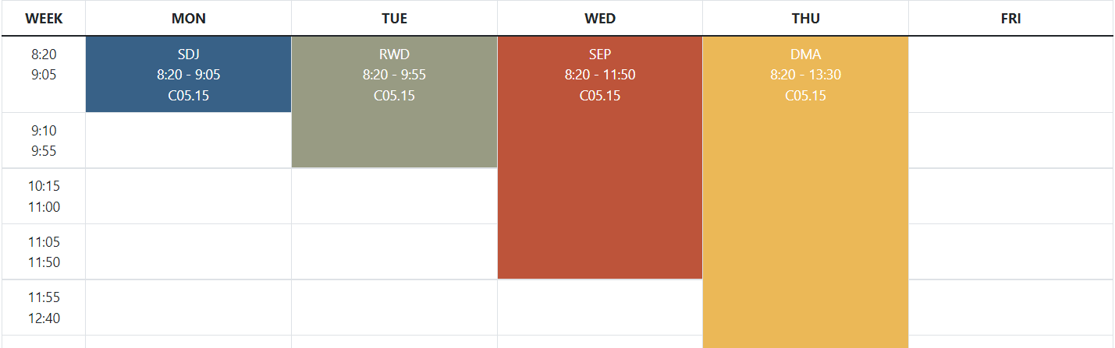
Rowspan Attribute
The “rowspan” attribute of the table cell will correspond to the “Number of Lessons” of the session.

Slide 18
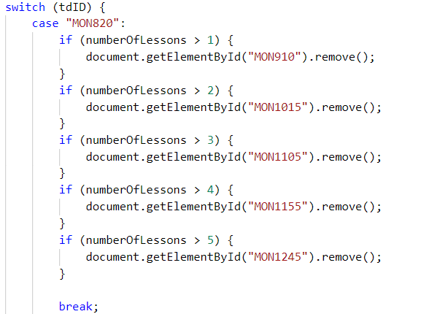
Removing “overwritten” table cells

Slide 19
Redoing the timetable
…

Slide 20

Testing Phase
Testing was done gradually throughout implementation, and extensively at the end.
It consisted of using and abusing the program to look for bugs & breaks.

Slide 21

Predictions VS Outcome
What the program can do;
What the website can do;
User’s interaction with the system;
Requirements met;
Requirements not met;

Slide 22

SEP + PBL = ?
Deep learning
Engagement
Autonomy
Self-fulfilment

Slide 23
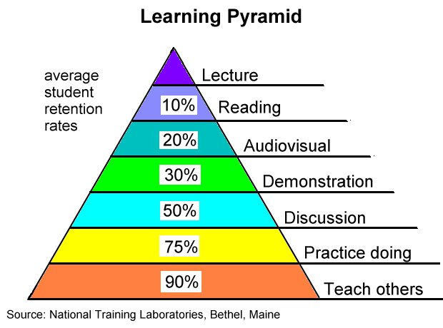
How we learned

Slide 24

PBL’s shortcomings
Without constant supervising, it became easier for us to get stuck in a task.

Slide 25
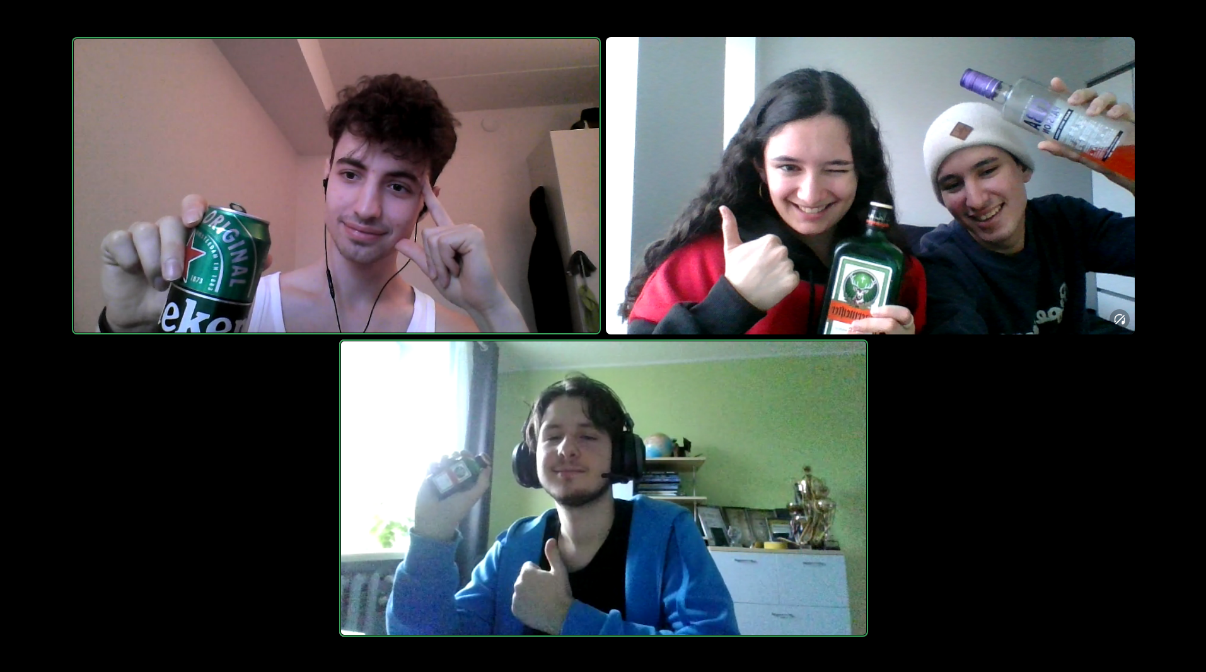
Thank you!

